Slide 1

Evergreen//One™
Customer Overview

Slide 2
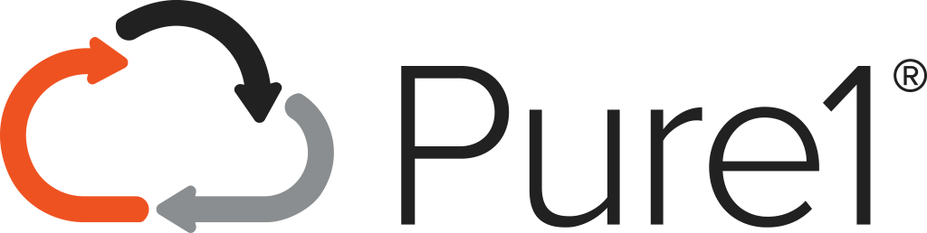



Evolve at Your Own Pace
Choice of multiple, flexible subscription models to meet your unique needs
Service
AI Ops
Asset + Usage
Subscription
Asset +
Subscription
NEW
Asset
SLA Driven Outcomes
Fleet Optimized Management
Forever
Architecture
Always Modern, Sustainable

Slide 3
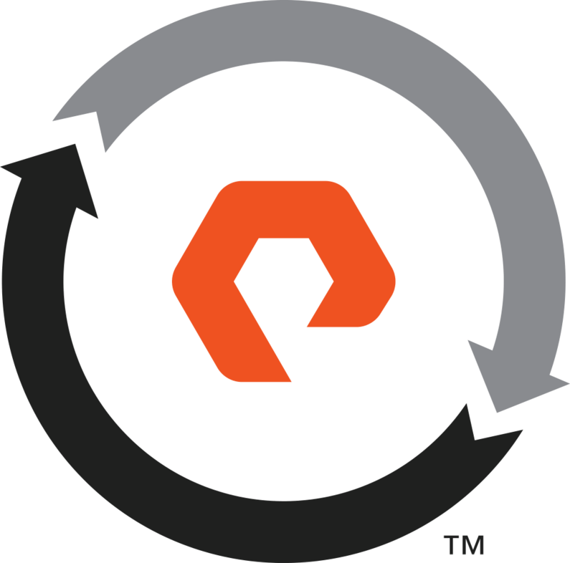
Evergreen Subscriptions
Providing choice in how you leverage your Subscription to Innovation
Evergreen//Forever™
Evergreen//Flex™
Evergreen//One™
Traditional purchase with ongoing subscription to
software and hardware upgrades
Hardware ownership with usage-based capacity
and software subscription
SLA-driven
Storage as a Service
Storage ownership combined with subscription to software and hardware upgrades and world-class customer experience.
Own and control the hardware with the flexibility to pay for the subscription based on utilization of purchased capacity.
SLA-driven storage service for customers that want cloud operations and cloud economics for their on-premises or hybrid data centers

Slide 4






Evergreen Portfolio Decider
How to decide which offering is right for you?
Requirements / Business Value:
Consumption Method:
Proposed Offering:
Service Guarantees (SLAs)
Capacity, Performance, Availability
Consume a Service
Hybrid Cloud Experience
On-Prem | Co-Lo | AWS | Azure
Evergreen//One™
Flexible Consumption, Configuration,
and Pay-as-you-go
Flexible Accounting – CapEx or OpEx eligible
IFRS-16 and ASC 842 compliant
Own the Hardware
On-Prem, specific array config
Purchase a
Product
Move purchased capacity
between arrays in a site
+
Pay for subscription based on
usage of purchased capacity
Own the Hardware
On-Prem, specific array config
Purchase a
Product
Eliminate storage re-buys
with flat subscription charges for
hardware & software upgrades
+

Slide 5
Ongoing Business Model Innovation
Evergreen//Forever™
Evergreen//Flex™
Evergreen//One™
CapEx Hardware
incl. Software
CapEx Hardware
Usage-based
Service Subscription
Usage-based
License Subscription
(Software + Evergreen//Forever)
Term-based Evergreen
Subscription to Innovation
Hardware-based consumption pricing
Storage as-a-Service
Evergreen Architecture
No Rebuys
Non-Disruptive SW/HW Upgrades
Usage Based SW Subscription**
Fleet Capacity Mobility**
SLAs for Performance, Capacity, and Availability
Full Opex Capable*
VALUE
Arrays, config, and capacity adapt to demand
HW Ownership
Customer
Customer
Pure
* Subject to End Customer financial accounting determination and alignment with internal budget management policy
** Based on purchased capacity, flexibility means the ability to move capacity between arrays within a site

Slide 6



Introducing Evergreen//One™
Fully Flexible Enterprise Grade Storage Subscription Service
Business Outcomes
Cloud Economics
Opex Capable
Cloud Experience
Simple, Fast, Everything
Transparency, Predictability
Cloud Operations
Edge / Hosted
MSP / GSI
Agility and Efficiency
Evergreen Architecture
Business Risk
Evergreen//One™
Service Catalog
No Tech Debt
SLA Driven
Core / On-Prem
Flex Up / Down
Unlimited On-Demand
Public Cloud
NPS Top 1%
Everything Included
No Exit Penalties
Notes:
Let’s define Pure as-a-Service. Pure as-a-Service is a fully flexible enterprise-grade storage subscription service, unifying and accelerating data management across on-prem and the public cloud.
It’s a subscription service for hybrid cloud storage where customers can consume foundational Block, File, and Object Storage Services on-prem or in the public cloud, underpinned by proprietary Pure technology.
It was the first hybrid cloud STaaS offering on the market.
Pure as-a-Service is not a lease in disguise. There is no hardware to purchases or a required large commitment of 70-80% of storage capacity upfront. Instead, Pure as-a-Service lets customers reserve as little as 50 TiB of storage capacity at a discounted rate, with access to unlimited on-demand consumption thereafter.
Pure as-a-Service can be extended beyond on-premises to the public cloud with Cloud Block Store, where customers can consume storage directly from the public cloud with Azure and AWS today, and possible GCP in the future.
So users can have one subscription across on-premises, Colocation/MSP/Service Provider, and/or the public cloud … enabling a unified experience across all deployments that matter to customers.
Customers can also consume Pure as-a-Service as part of a broader managed storage services offering that MSPs and GSIs might offer…where the on-prem equipment is hosted in their data centers, along with other infrastructure services they provide to customers.
Everything that Pure offers in terms of guarantees is included…all of the S/W and maintenance required to maintain the deployed infrastructure…all included.
The nature of the service is that its unlimited on-demand… the more data a customer loads into the platform, the more Pure could provision additional capacity so that the customer does not run out of capacity. More detail on that later.
We offer short terms and low commitments to become a subscriber, and no exit penalties at the end of a term, even if we’ve been deploying new infrastructure during the term. So unlike a lease, we get to the end of the term and the customer has very simple options, they can walk away/discontinue the service and we just reclaim the arrays; they can choose to extend their agreement, where they can then renegotiate unit rates, change the level of reserve commit, add sites, etc…
And if nobody does anything, there’s a safety net clause that says the subscription will automatically renew for 12 months with the same level of reserve commit that you ended the term with.
So it’s designed to be fully flexible, fully agile and ultimately help customers to mitigate risk of over-provisioning, or having rigid inflexible storage platforms.
===================
Avoid expensive financing, upfront capital costs and limitations on the use of cloud-
native infrastructure by selecting a consumption plan that’s deployed on a hybrid cloud IT platform.
Avoid potential hidden costs and SLA compliance issues by ensuring that selected vendors have invested appropriately in the AIOps tools and platform capabilities needed to underpin SLA commitments.
Eliminate inefficient use of hardware assets by replacing asset-centric operation
methods, processes and IT budget outlays with pay-for-use offerings that preserve
asset utilization value.
Plan to exit hardware administration, support and maintenance by partnering with platform vendors that provide life cycle management capabilities, which maintain optimal asset utilization.
align asset utilization to SLA value-based pricing.

Slide 7


Introducing Evergreen//One™
Subscription Model for Storage On Prem and in the Cloud
Cloud
Economics
Bring financial flexibility to your organization
Avoid the non-strategic work of on-going management, upgrades, and data migrations
Deliver a consistent and unified experience
On-Prem | Co-lo
Cloud
Operations
Block
Evergreen//One
Private
Public
Cloud
Experience
Unified Subscription for Hybrid Cloud
Block | File | Object
Storage as-a-service
Block
Cloud Economics: FinOps that work using a unified subscription and universal credits
Cloud Operations:
Pure1 AI-powered monitoring & management.
Portworx Essentials
SLA-Based Outcome:
Evergreen™ Enterprise Technology, Delivering SLAs, and non-disruptive maintenance & upgrades
Cloud Experience:
SaaS management and API-based orchestration
© 2022 Pure Storage
Uncomplicate Data Storage, Forever
8

Slide 8
No ELA / TLA
Commitments are controlled by you, and are solely related to your forecasted usage (data).
No Penalties
No end of term penalties or balloon payments of any kind - even if we have delivered upgrades or deployed additional infrastructure during the term.
_
No Maintenance
No concept of maintenance charges, there is no separate cost for maintenance with Evergreen//One™. Pure continuously maintains and updates the technology we deploy to avoid attracting technical debt.
No Ultimatum
No ultimatum – at the end of each subscription term, scope and commitment can be reset, so it is impossible to end up “handcuffed” to the service.
No Assets
Pure deploys and manages the storage infrastructure needed to deliver the service, but your new storage consumption model is based purely on the amount of data you have at any point in time.
No Risk
Offload commercial and operational risk to Pure. No need to over-commit or over-provision. Just forecast the consumption, and Pure will evolve the deployed solution non-disruptively to ensure you always have enough capacity and performance.

Slide 9
How it Works

Slide 10
Evergreen//One™ vs Other ‘Flexible‘ Models
Dynamic, fully flexible, hybrid cloud storage as-a-service, vs capacity on request
Evergreen//One™
Other ‘flexible’ Models
You choose a tier of service, Pure manages the technology
Pure adjusts deployed capacity dynamically and non-disruptively
You pay for what you use, and get discounts in return for reserve commitment (to a level of usage, not capacity)
Pure takes the risk of performance not being sufficient
Pure takes the risk of DRR declining
All software features included at no extra charge
Premium Support and designated resources bundled
All upgrades, and continuous maintenance included
Non-disruptive architecture enables seamless change
You have to choose the technology (array model) up front
You have to specify the capacity, and request more when you need it (and increase your commitment in the process)
You have to commit to a percentage of the deployed capacity, and then pay for that plus any ‘buffer’ you use
You take the risk of performance not being sufficient
You take the risk of DRR declining, with significant penalties
Replication, encryption, and DR capabilities often charged for
Designated resources typically not included
Break/fix maintenance only
Upgrades / significant changes require planned outages

Slide 11













Evergreen//One: Enterprise-Grade SLAs
PREMIUM SUPPORT
SERVICE LEVEL AGREEMENTS
Case Handling
No Scheduled
Downtime
Availability
Capacity
Performance
Efficiency
Severity 1 Response: 15 Mins
Severity 1 Resolve: 4 Hrs
For Upgrades or Maintenance
99.9999%
Uptime Guarantee
25% Buffer
Relative to Usage
MB/Sec or IOPS/TiB
Aligned with
Service Tier
Watts/TiB
Aligned with Service Tier & Minimum Commit
6 Global
Support Centers
Hotline: 365x24x7
Proactive Monitoring
Remote SW Upgrade
Response Time Sev1 15 min
HW Replacement Sev1: 4 Hours
Training &
Admin Guides
Service Metering
SLA Measurement
Capacity
Management
Solution Design
Non-Disruptive
Upgrades
Customer Success
Manager
Feature Adoption
Service Reporting
Fingerprinting
Real-time Analytics
Installation
Integration
Service Account
Manager

Slide 12
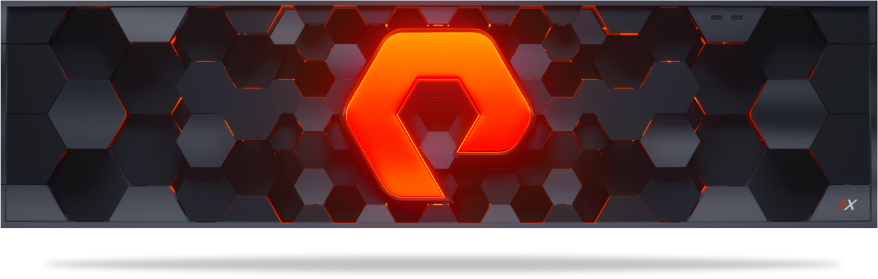
Evergreen//One™ Catalog
🗶
RAW
Capacity
🗶
Usable Configured
Capacity
✔
🗶
Effective
Capacity
Total Effective Capacity
Think Consumption, not Capacity. Data, not Storage.
Effective Used
Capacity
✔
Services | //Block (On-Prem & Public Cloud) |  |  |  | //UFFO (Unified Fast File and Object)
Tiers | Ultra | Premium | Performance (incl CBS) | Capacity | Ultra | Premium | Performance
Example Workloads | In Memory DB, Oracle, VDI / Virtualization, Production Database, Containers |  |  | IoT, Capacity, Snapshots | AI/ML, Analytics, EDA | Rapid Restore, Code Repositories, S3 Enabled Apps | Rapid Restore, Code Repositories, S3 Enabled Apps
Relative Performance¹ | 20x | 10x | 5x | 1x | 6.5x | 2.5x | 1x
Minimum Commitment | 50 TiB | 50 TiB | 50 TiB | 200 TiB | 75 TiB | 100 TiB | 150 TiB
Minimum Term | 12 Months | 12 Months | 12 Months | 12 Months | 12 Months | 12 Months | 12 Months
¹ Relative Performance in Block IOPs or File/Object Throughput Detailed in KB
Notes:
The new Evergreen//One™ 2.0 creates 6 new service tiers designed to more closely align with enterprise workload requirements, and simplifies subscription management by allowing customers to select the specific tiers required by their applications rather than simply choosing block, file, or object services. This model is similar to hyperscalers like AWS and Azure, and provides unmatched flexibility.

Slide 13
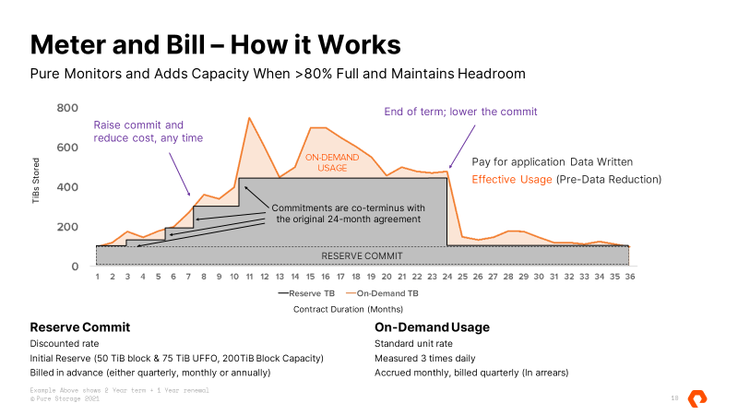

Slide 14
Billing
Quarterly Billing Schedule as Standard (Monthly and Annual are available as options)
Process
Each site is measured separately and has its own Reserve Commitment (to a level of usage, not an amount of capacity)
Daily average used – average across multiple data points spread out over the day
Calculated daily rate for reserve and on-demand usage
Calculated usage for each day accruing to month and quarter
1st of the Month
Generated on service start date that is set as 4 weeks after the signature (6 weeks APJ)
Invoice contains:
      Setup fee + install fee (if applicable)
      First quarter’s Reserve Commitment charge as provided in the original quote and / or Product Schedule
Quarterly
Generated every three months from the service start date
Invoice contains:
    Up-front Quarterly Reserve Commitment charge
    True-up for incremental Reserve Commitment expansion
  Invoices for On-demand usage are charged in arrears, pro-rated to a daily charge rate, and issued calendar quarterly

Slide 15







Evergreen//One™
Flexible Hybrid Cloud
On-Premises in
Your Data Center
Co-Location / Hosted
Within the
Public Cloud
Connected to Public Cloud
ActiveDR™ (Near Sync) | ActiveCluster™ (Sync) | Async | Purity CloudSnap™
S3
Glacier
+
Hybrid Connection
EBS
EC2
AWS
DirectConnect
AZURE
ExpressRoute
Notes:
Now, bringing it all together. You can start with Evergreen//One™ on-premises – in your data center. We can add co-located or hosted Evergreen//One™. We can also offer Evergreen//One™ with Cloud Block Store in the cloud – running on top of AWS. You can then add ActiveCluster and/or Asynchronous mirroring between locations. CloudSnap supports backup to object storage such as S3. Then you can also attach your collocated Evergreen//One™ storage services to your compute in the public cloud, enabling a multi-cloud option. You have a wide variety of choices to build a robust hybrid cloud.

Slide 16







Capacity Monitoring, Planning, & Logistics
In partnership with a Services Account Manager (SAM) and Sales Engineer (SE), the CSM is responsible for monitoring, tracking, reporting on hardware usage, utilization, forecast & capacity planning
If the hardware is not meeting performance expectations, the Evergreen//One CSM will work with the appropriate teams within Pure to RMA, replace and return hardware
Evergreen//One CSM & Operations teams are responsible for coordinating hardware procurement, replacement and RMA, including decommissioning and return of the assets
Responsibilities include:
Hardware configuration (BOM) | Order creation in Salesforce | Coordination with Pure Fulfillment team to procure orders | Coordination with Pure Professional Services to schedule and complete installations, upgrades, expansions and decommissions | Coordination with Logistics teams to ensure tracking and delivery of shipment | Coordination with the Customer Returns team to ensure timely and accurate return of hardware | Reporting of order creation, fulfillment, delivery and issues tracking
Notes:
ePlus - add to this slide

Slide 17
Customer Success Engagement Checklist
Item # | Action / Deliverable | Contact | Date Due / Delivered
1 | Identify key contacts for the Evergreen//One CSM and provide contact details | Pure Storage AE
2 | Account team to provide Evergreen//One team a warm handoff to customer contact | Pure Storage AE
3 | Schedule Evergreen//One Kickoff call with customer | Pure Storage CSM & TSE / CUSTOMER
4 | Kick-off call: w/ customer | Pure Storage CSM & TSE / CUSTOMER
5 | Coordinate installation (date, resource, timeline) with Pure PS / Partner / SE (if applicable) | Pure Storage CSM / CUSTOMER
6 | Discussions of goals, priorities and objectives for the next 30 and 90 days | Pure Storage CSM / CUSTOMER
7 | Discuss timing of Quarterly Business Review (QBR), Capacity Planning, and next steps | Pure Storage CSM / CUSTOMER
8 | 15-day post service launch check-in; check deployment status | Pure Storage CSM
9 | ~2-month check-in: schedule QBR for 90 - 120 days out from service start date | Pure Storage CSM
10 | Schedule Training & Checkpoints (AS NEEDED) | Pure Storage CSM & TSE/ CUSTOMER
Notes:
ePlus customize information

Slide 18
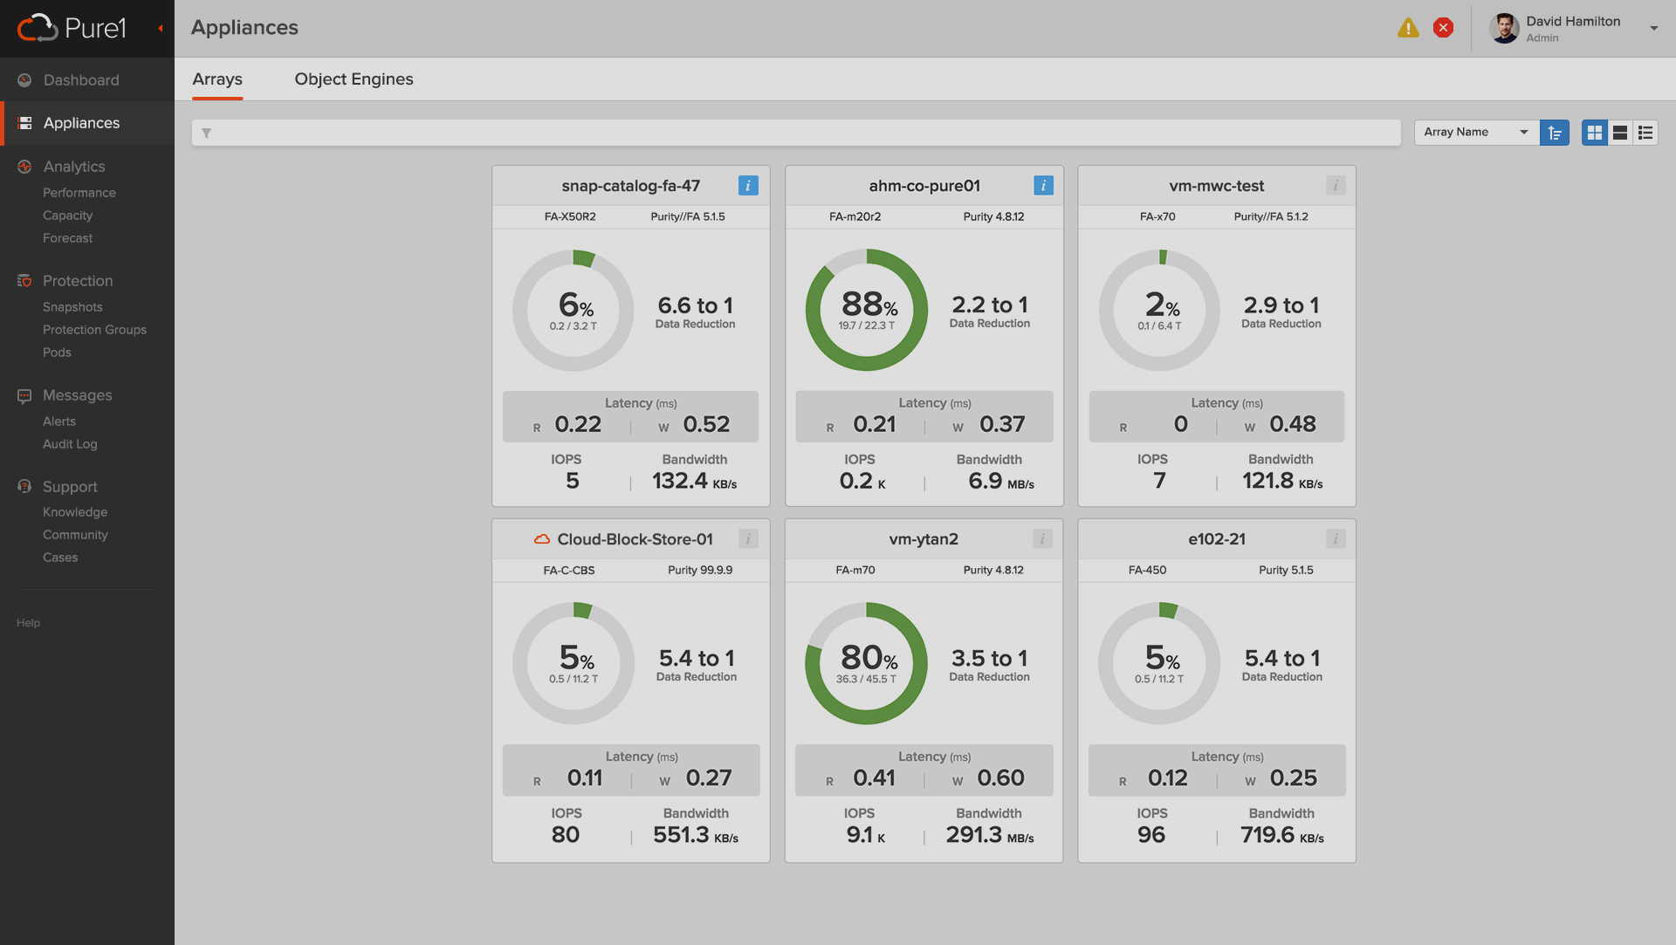
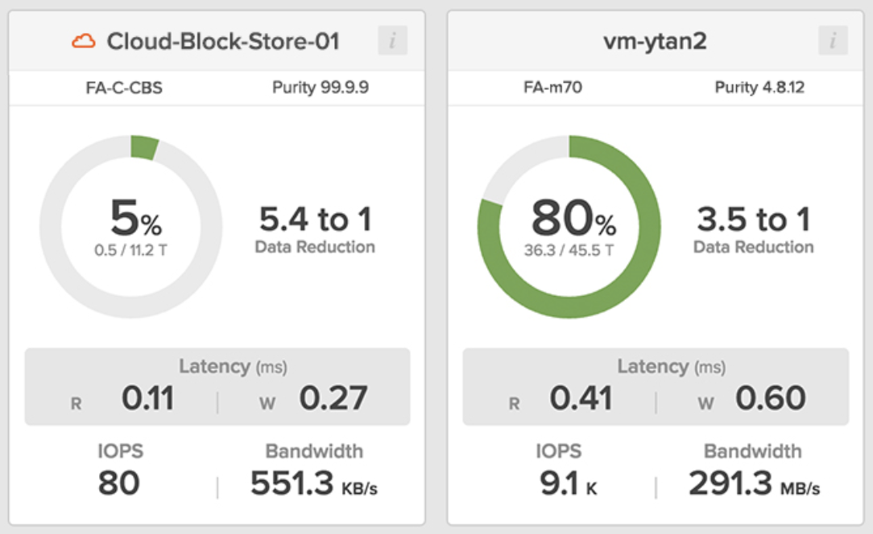
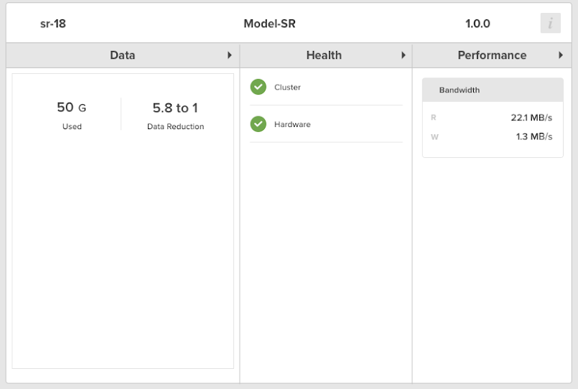
Pure1:
Consolidate Monitoring
On-Premises to Cloud
Aggregated fleet metrics:
Capacity utilization
Performance
Data reduction savings
Alerts and support cases

Slide 19
Environmental Impact
How does the Pure solution compare?
Competitor
Pure Storage
The Same as
The Same as
320
Tons of CO2
per annum
70
passenger vehicles driven for one year.
68
Tons of CO2
per annum
15
passenger vehicles driven for one year.
3.5M
KWh per annum
320
Rack Units
757,425
KWh per annum
48
Rack Units
According to the IEA, Sweden has one of the lowest Final Energy Carbon Intensity rates in the World. The rate used in these illustrations is 25.2g CO2 / MegaJoule. https://www.iea.org/data-and-statistics?country=SWEDEN&fuel=CO2%20emissions&indicator=FECI

Slide 20
Integration & Automation

Slide 21
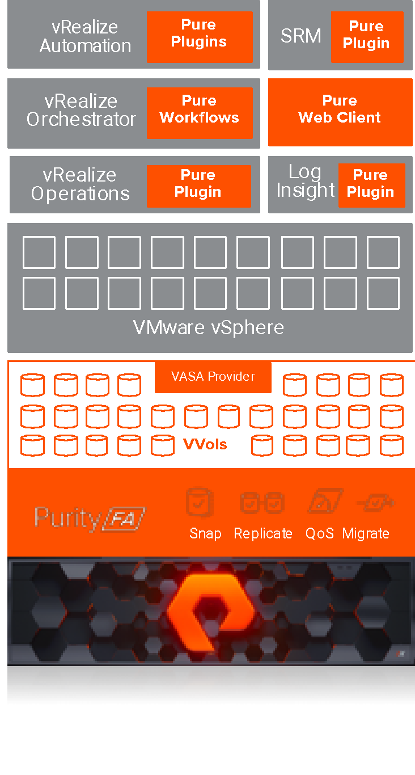


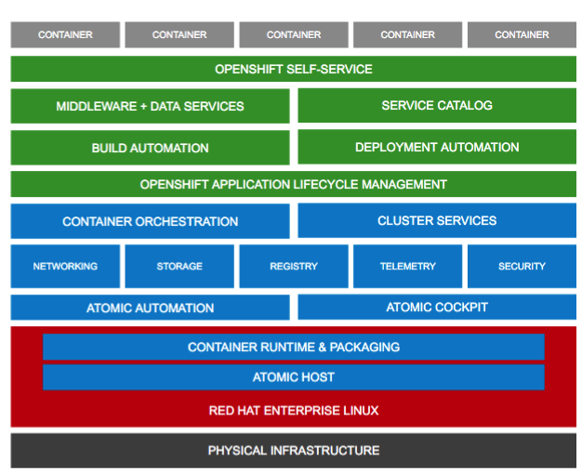












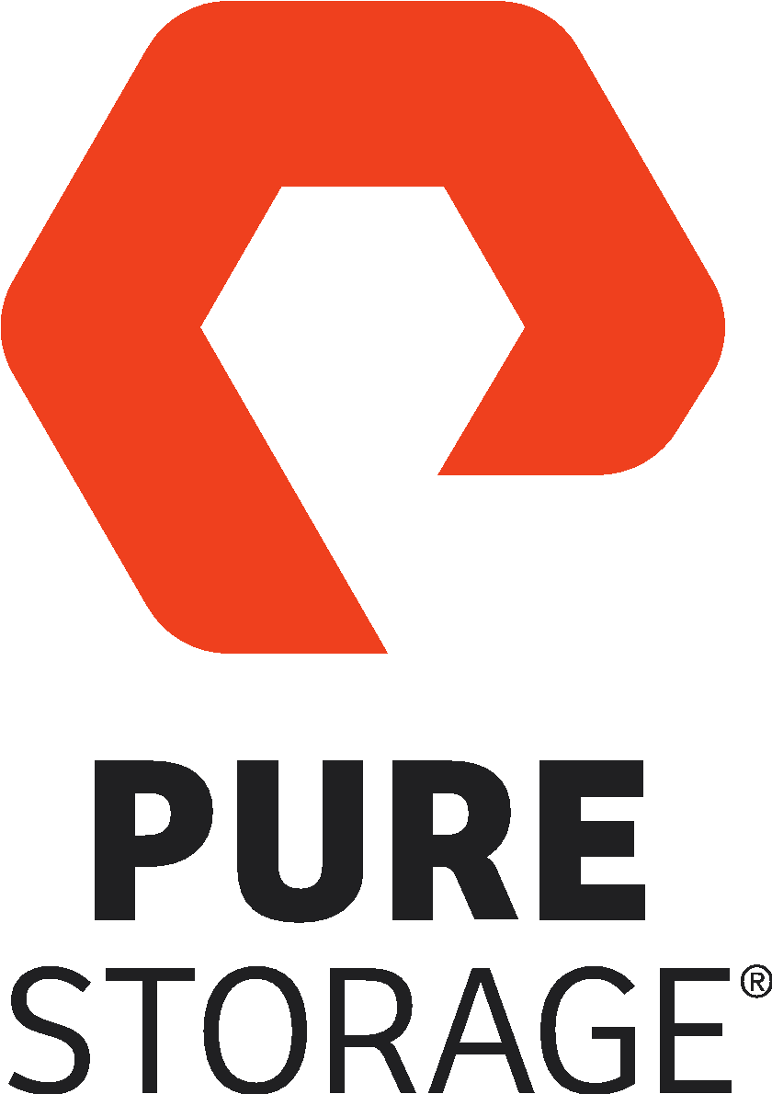
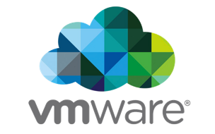



Automate and Orchestrate
…On Every Cloud Platform
VMWARE SDDC
OPEN AUTOMATION
OPENSHIFT PaaS
CONTAINER-BASED PaaS
REFERENCE ARCHITECTURE
PRE-BUILT OPEN FULL-STACK
AUTOMATION TOOLKITS
VMware SDDC VALIDATED DESIGN
+
A FULLY-AUTOMATED VMWARE CLOUD
+
+
PURE STORAGE

Slide 22



Next-Gen Private Cloud
+
Increase
Agility
Simplify
Storage Ops
Speed Performance Resolution
Span SDDC Across
Next-Gen Platforms
Expand Cloud Management
Integrations & Certifications
vCenter
Server®
vRealize Automation
vRealize
Orchestrator
vRealize®
Operations Manager™
vRealize
Log Insight
Metro Storage Cluster
Site
Recovery
Manager™
Virtual Volumes & Storage Policy Based Mgmt
Horizon
VMware Validated Design
VMware Cloud Foundation
Notes:
As mentioned we have been working with VMware over the years to integrate with their capabilities. This slide shows the extensive offerings available to customers.
From our integrations with vCenter and vRealize where you can manage your storage all thru VMware, performing comprehensive operations management to automating and delivering self-service of storage resources as an example.
With our unique ActiveCluster capability integrated with VMware Metro Storage Cluster and Site Recovery Manager, we can deliver an end 2 end business continuity solution for your virtualized environment.
For customers looking at end-user computing, we have tested and certified reference architecture built with Horizon supporting up to 6000 virtual desktops in a FlashStack environments.
We are also the first 3rd party SAN certified with the VMware Validated Design which is a pre-tested and validated reference arch for customers looking to build a VMware software-defined data center.
VMware introduced VMware Cloud Foundation which is inclusive of VMware software stack to enable the stepping stone to customers hybrid cloud journey. As of today, VCF supports iSCSI which Pure is certified with, and they look to expand this over time.

Slide 23
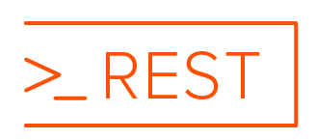




Automate Your Environments
PURE IS API
FIRST!
Seamlessly integrate with Bare-Metal, VM & Container-Based Clouds
Containers
Hybrid
VAAI
VVOLs / VASA / SPBM
vCenter Plugin
vRealize Automation XaaS Integration
vRealize Orchestrator Plugin & Workflows
vROps Management Pack
vRealize Log Insight Content Pack
SRM Storage Replication Adaptor
vMSC ActiveCluster Cert.
Private Cloud VMware Validated Design
VCF Interoperability
SCVMM
ODX
Azure ExpressRoute
Azure Cloud
SMI-S
PowerShell Toolkit
VSS Provider / Requestor
SCOM Management Pack
Full In-Tree Cinder Driver
Fuel Plugin
Python SDK Library
OpenStack Foundation Corporate Sponsor
Core Cinder Team Member
Portworx Essentials
Portworx Enterprise
Portworx Data Services
Docker Plugin
Kubernetes Plugin
OpenShift RA
MesoSphere
DVD-CLI
Docker Swarm
OpenConnect for AWS
OpenConnect for MS Azure
CloudSnap

Slide 24


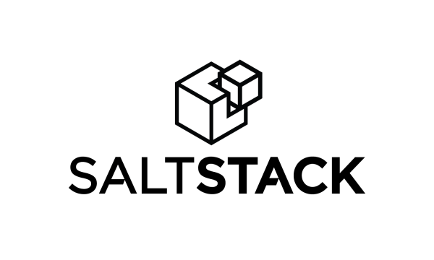




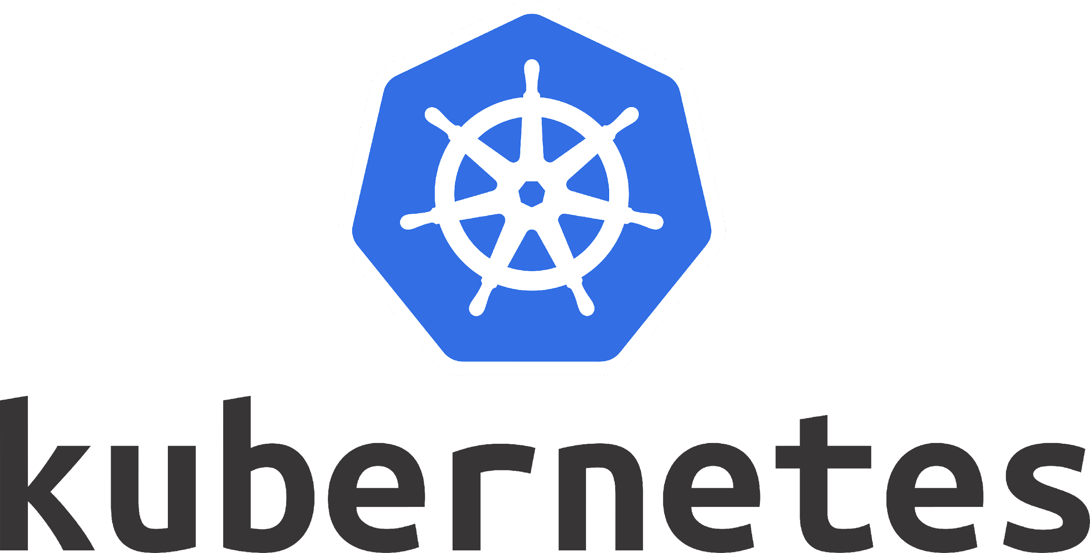
Automation & Monitoring
Pure provides full stack, open automation & monitoring to support customers with transforming their environments.
Pure supports containers and virtualization and it’s been pre-integrated into all the popular full-stack orchestration & monitoring tools.

Slide 25

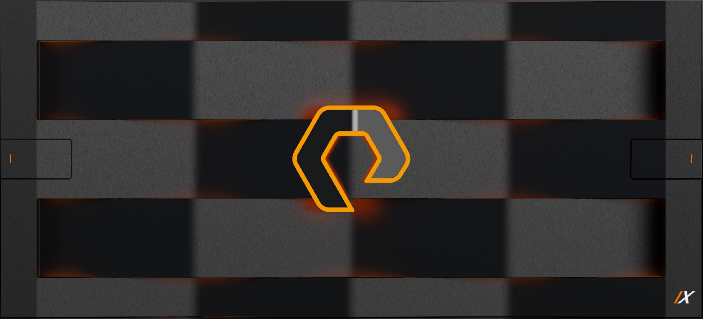
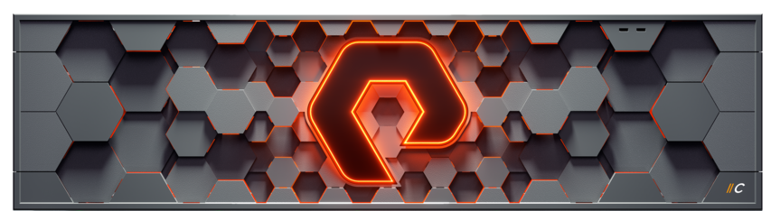
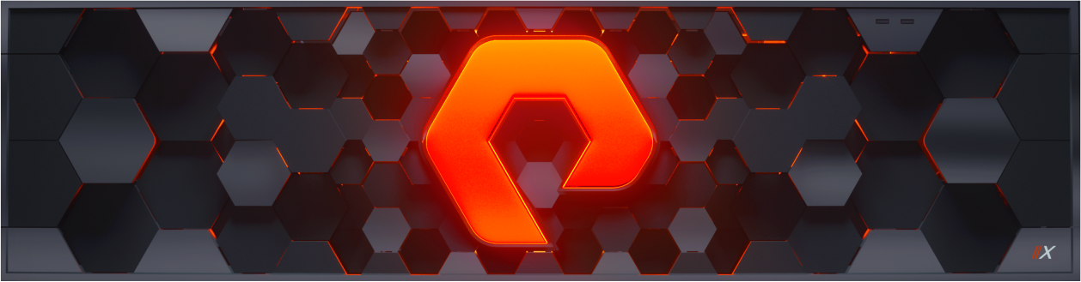



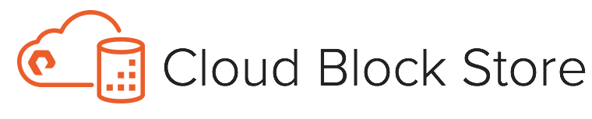
Purity//FA: FlashArray’s Software Heart
Unparalleled data storage - 10:1 data reduction, 99.9999% availability, encryption
Trusted protection and recovery - Built-in business continuity & ransomware protections
Effortless data access - End-to-end NVMe. Multi-protocol support for FC and Ethernet
Intelligent management - AI-driven ops. Mobilize workloads across on-prem and cloud.
Efficient. Trusted. Flexible. Intelligent.
Notes:
Unparalled data storage - Up to 10:1 data reduction, 99.9999% availability, always-on encryption
Trusted protection and recovery - Built-in, automated business continuity, disaster recovery, with rock-solid ransomware capabilities
Effortless data access - End-to-end NVMe. Multi-protocol support for FC and Ethernet.
Intelligent management - AI-driven, optimized management operations. Mobilize workloads across on-prem and cloud with a unified operations.

Slide 26



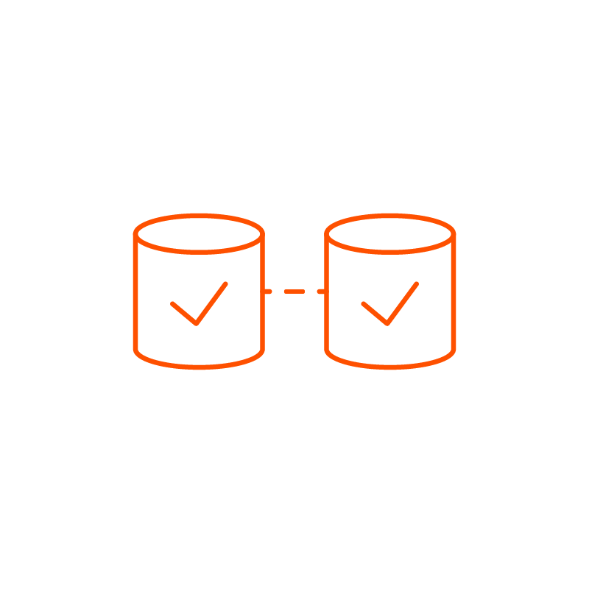

FLASHARRAY PROTECTION FEATURES
A WIDE RANGE OF DATA PROTECTION & AVAILABILITY FEATURES BUILT-IN
Local Protection
Disaster Recovery
Data Archive
Business Continuity
Business Resiliency
Snapshots
Replication
Cloud Integration
ActiveCluster™
ActiveDR™
Lightweight and immutable snapshots
Fast protection and recovery
Asynchronous replication
Periodic data copy to
DR site, COLO or MSP
Snapshot offload
Long-term storage in cloud or NFS targets
Synchronous replication
Real-time array failover
Continuous replication
Unified Replication
Pure1® Monitoring | Predictive Support | Purity REST APIs for Automation
Notes:
PureStorage FlashArray has a wide-range of data protection and availability features built-in so you can easily create an integrated data protection strategy.
Lightweight and immutable snapshots are used to protect data on your local FlashArray, for long-term data archive to cloud or NFS targets, as well as periodic off-site copies.
ActiveCluster, on the other hand, provides fully synchronous replication with automatic and real-time array failover for business continuity within the same campus or city.
With the introduction of ActiveDR, FlashArray can now also improve business resiliency across long distances with simple, continuous data replication.
ActiveDR is available starting with Purity6.0. with no additional licenses or fees.
With an active Evergreen subscription, you simply upgrade and are ready to go.

Slide 27
Win Stories

Slide 29




Meaningful Service Measures
Case Handling SLA
Severity | Description | Response
1 | Critical impact to a critical business system which is preventing business functions from operating, resulting in loss of productivity or financial impact including data loss or data corruption. | 15 mins
2 | Major impact to a critical business system with reduced or degraded functionality impacting productivity or financial loss | 30 mins
3 | Minor impact or degradation of service to business system impacting non-essential functions with minimum or no impact to business. | 1 hr
4 | Informational inquiries including request for documentation, questions on product functionality or configuration. | 2 hrs
Capacity SLA
25% Buffer Capacity at all times, dynamically increases with usage (up to 1PiB per-site)
Performance SLA
Sub-ms all flash storage performance; IOPs/TiB of the subscribed service tier
Availability SLA
Pure can provide Evergreen//One with zero Planned Downtime such that the client is entitled to a Downtime Credit equal to 100% of the monthly charges on any System that experiences Planned Downtime. The Uptime percentage is calculated across the environment on a monthly basis, based on 24-hours a day, 7 days a week, calculated as follows: Uptime Percentage = (total minutes in calendar month) - (downtime minutes) / total minutes in calendar month | Uptime / Month | Downtime Minutes / Month | Credit
 | 99.9999% | <2.0 secs | 3%
 | 99.999% | <26 secs | 5%
 | 99.99% | 4.4 mins | 10%
 | 99.95% | 21.9 mins | 25%
 | 99.9% | 43.8 mins | 100%
Case Handling
Availability
Capacity
Performance

Slide 30
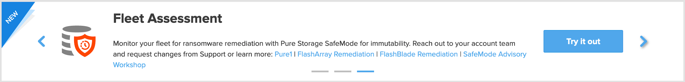
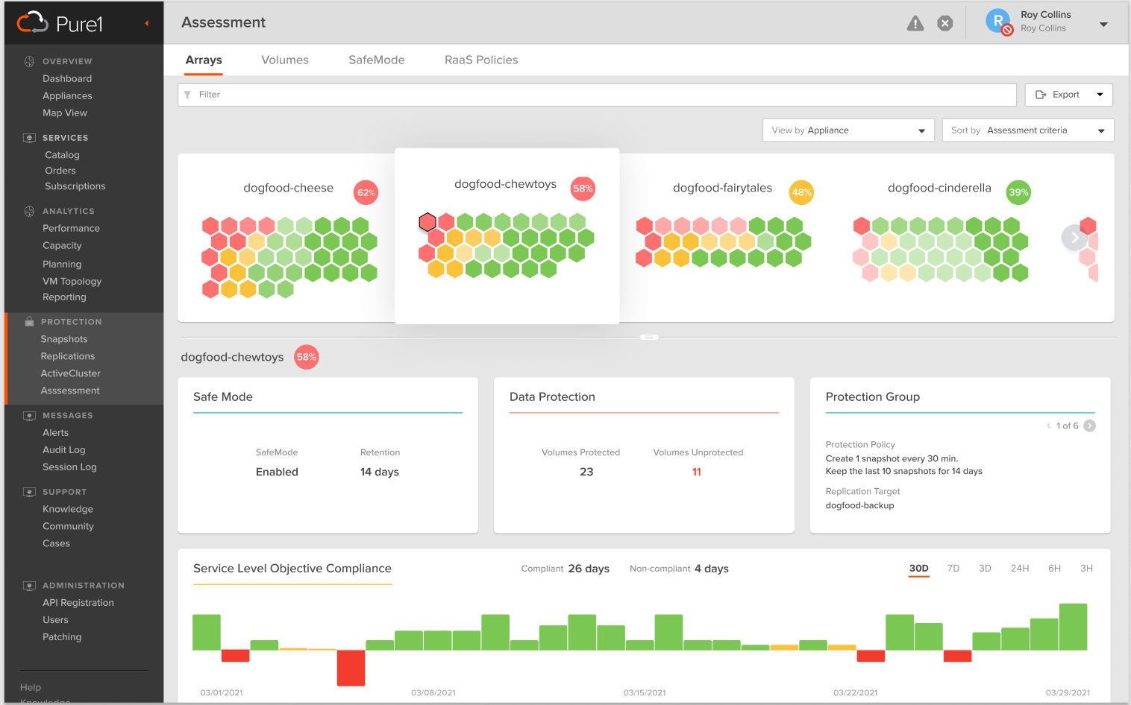
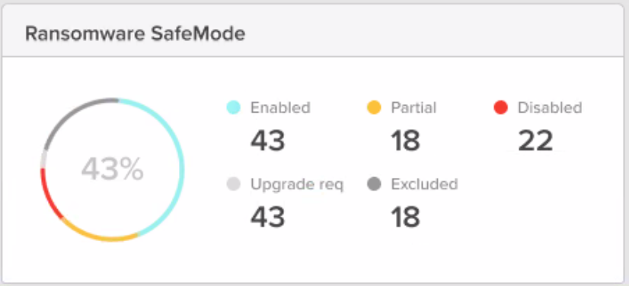
Data Protection Monitoring
Checks if protection services are meeting RPOs
Delivers local and remote protection report
*Coming soon!* RTO / RPO and ransomware alerting
*Coming soon!* Recommend and quote safeguards
Deliver peace of mind from downtime, data loss, or data destruction and a path to integrated data protection as a service

Slide 31
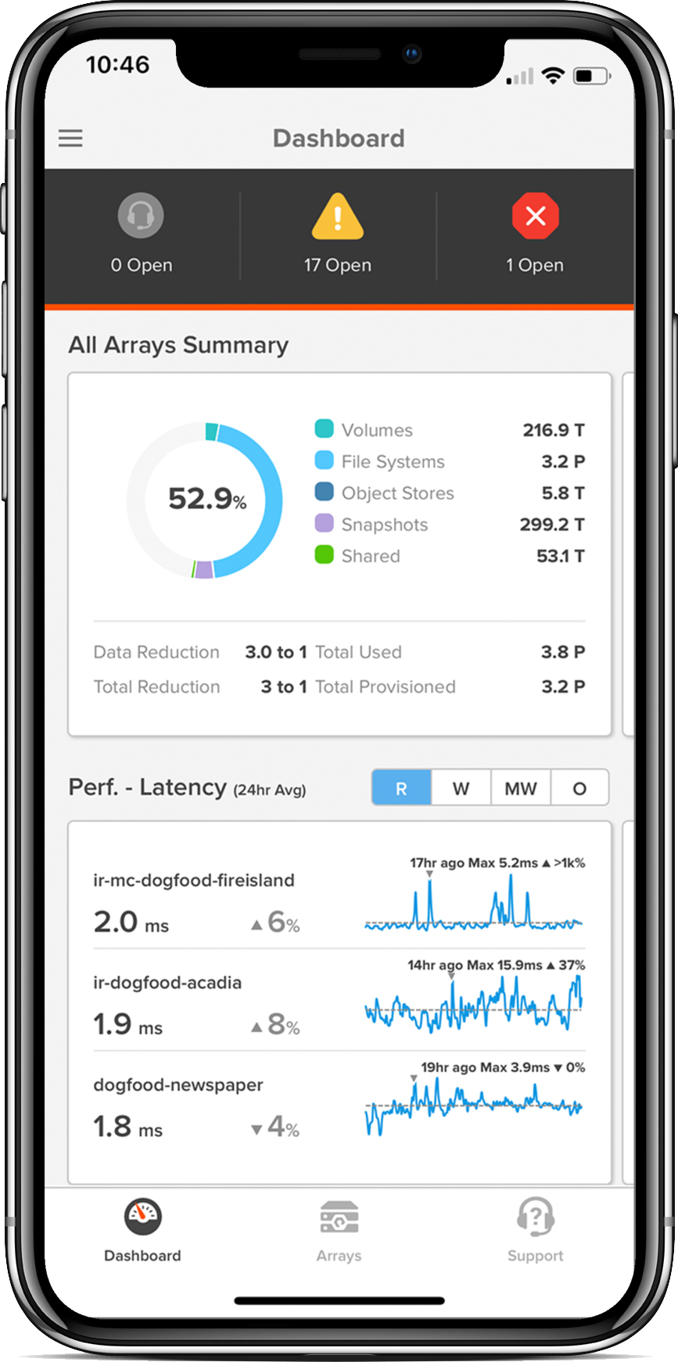
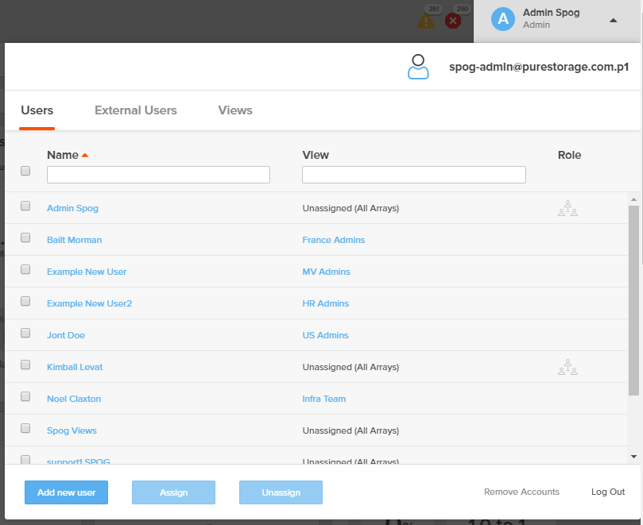
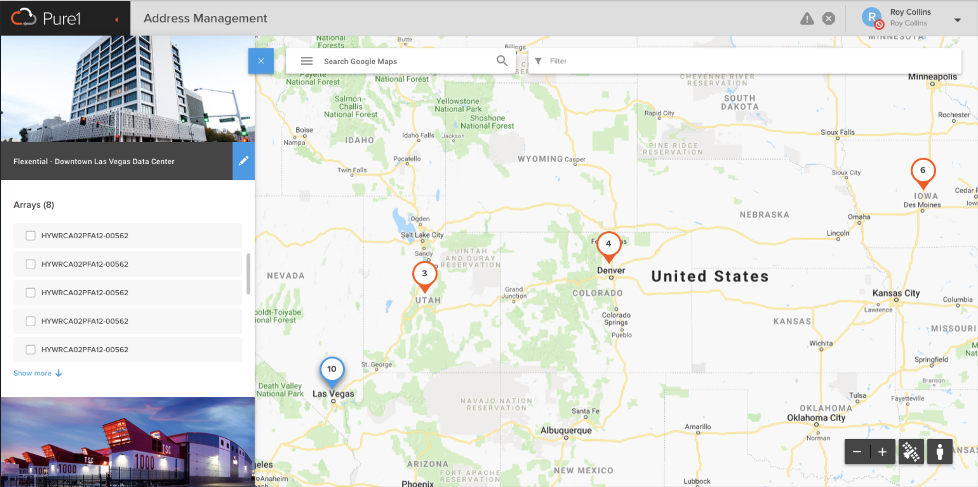
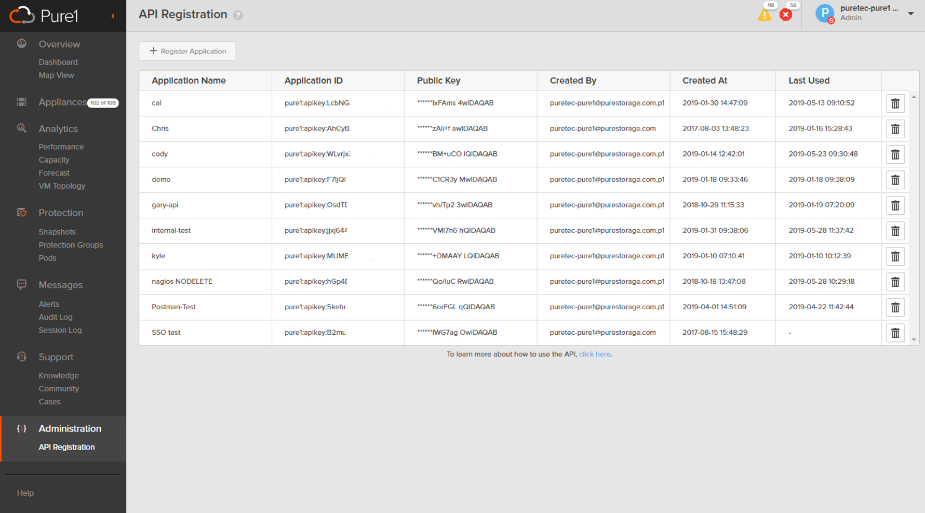
Manage Any Resource from Wherever You Work
Leading mobile, global interface for monitoring and taking real-time action
Entire Fleet at
Your Fingertips
Monitor your arrays and update cases right from your pocket
Secure Role-Based Access for All Users
Provide specific views based on user profiles
Location
Management
Know exactly where all your data sits—globally
Simple Integrations
Using APIs
Want to use your own reporting and graphing tools? Pure1 is API-first!

Slide 32




Operational Benefits
How does Evergreen//One™ reduce Customers’ cost of delivery to end customers?
OUTSOURCED TASKS
OPERATIONAL SIMPLICITY
OPERATIONAL FLEXIBILITY
MITIGATED COMMERCIAL RISK
Capacity Management
Performance Management
Monitoring & Reporting
Typical Retained FTE Saving:
40%
Pure1 Management Plane
Deep ITSM Integration
Fewer Managed Changes
PB to Storage Admin Ratio:
10:1
Flex up / down
Everything Included
Continuous Upgrades
Required Budget:
$0
Pure owns the assets
Pure provides SLAs
No exit penalties
Required Budget:
$0
Typical Cost Reduction for Customer Retained Teams: 80%

